Slide 1

Digital Prescription Record Analyst

Slide 2

Objective
Analyse digital prescription records to extract insights on:
Prescription trends
Doctor/patient behaviour
Drug usage & anomalies
Geographic patterns
​
Enable smarter healthcare planning through data.​

Slide 3
Tools & Technologies
MySQL
Python
Pandas
Storing and querying prescription & drug data
Data processing, logic, and visualization
Data manipulation and analysis
Matplotlib & Seaborn
Logging
Visual representation of data
Tracking execution and errors

Slide 4
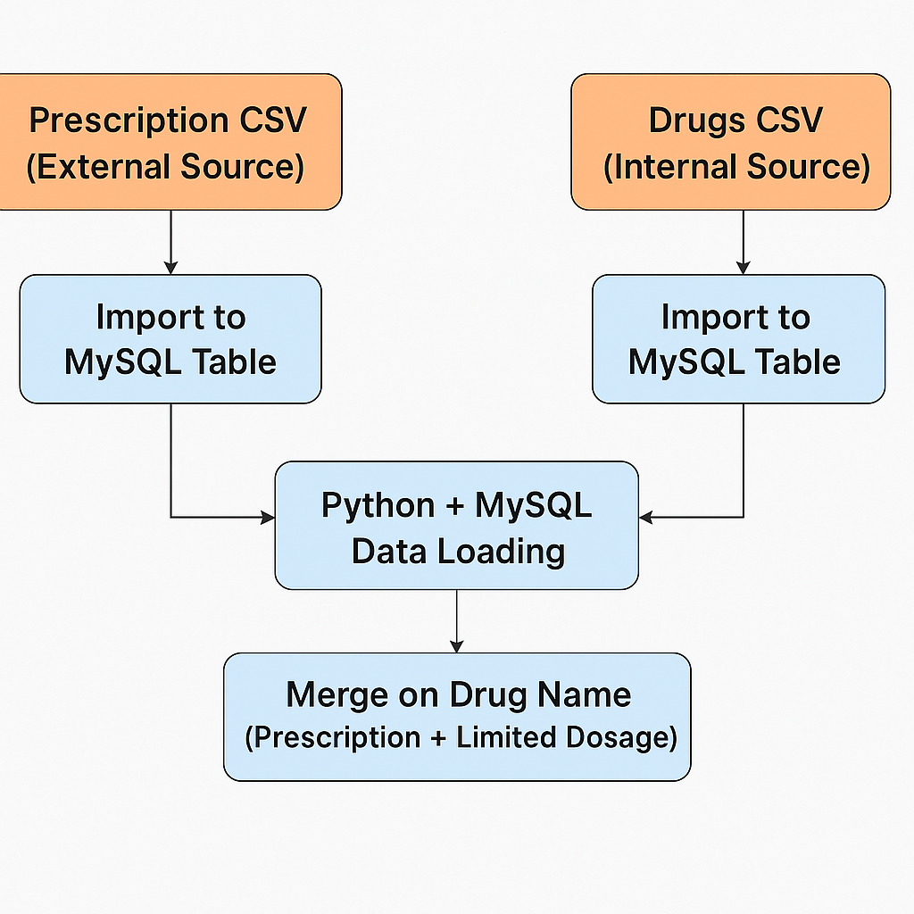
Data Collection & Preparation
Prescription Data sourced externally (CSV)
Drug Data created internally (CSV with dosage limits)
Both files imported into MySQL for structured storage
Connected to MySQL using Python for analysis
Datasets were already clean and standardized
Merged limited dosage info into prescription data using drug name as key

Slide 5
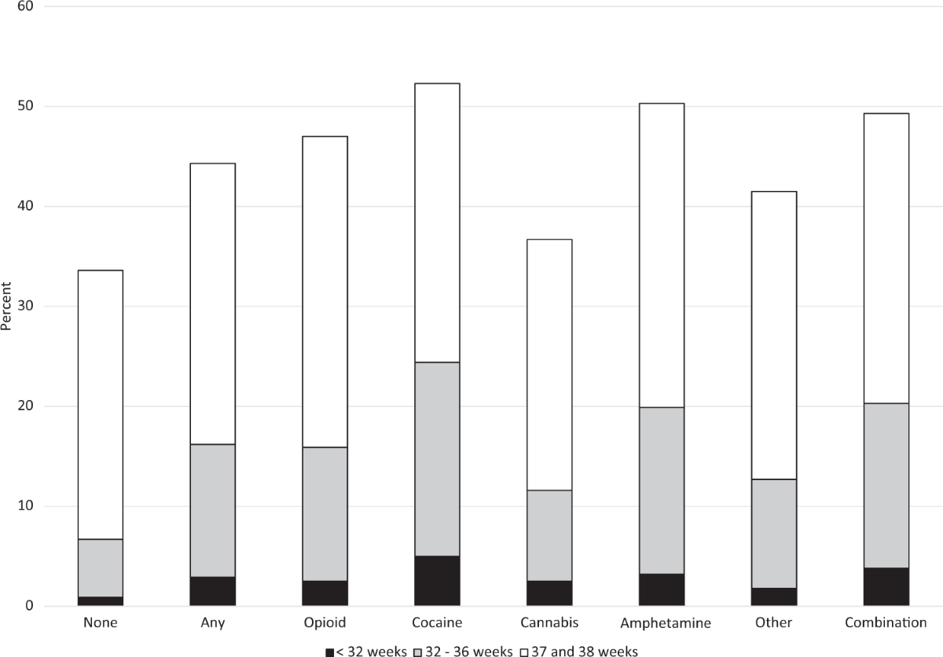
Analysis Modules

Slide 6
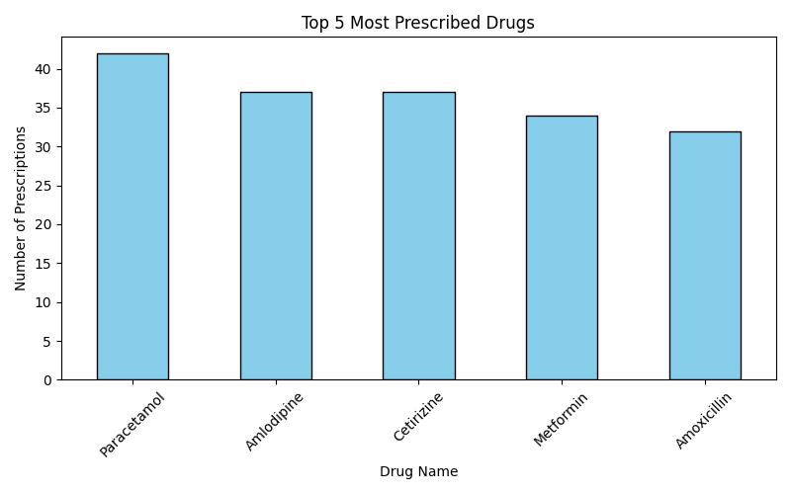
Prescribing Trend Analysis
the most frequently prescribed medications, indicating overall demand and usage patterns.

Slide 7
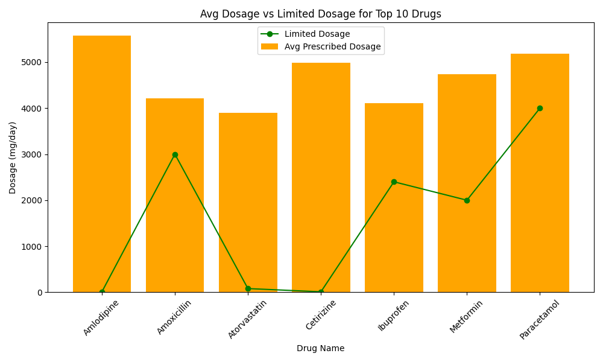
Dosage Utilization & Pattern Analysis
Paracetamol:
Avg dosage = 500mg,
Limited dosage = 650mg → Under-prescribed
Amoxicillin:
Avg dosage = 800mg,
Limited dosage = 500mg → Over-prescribed

Slide 8
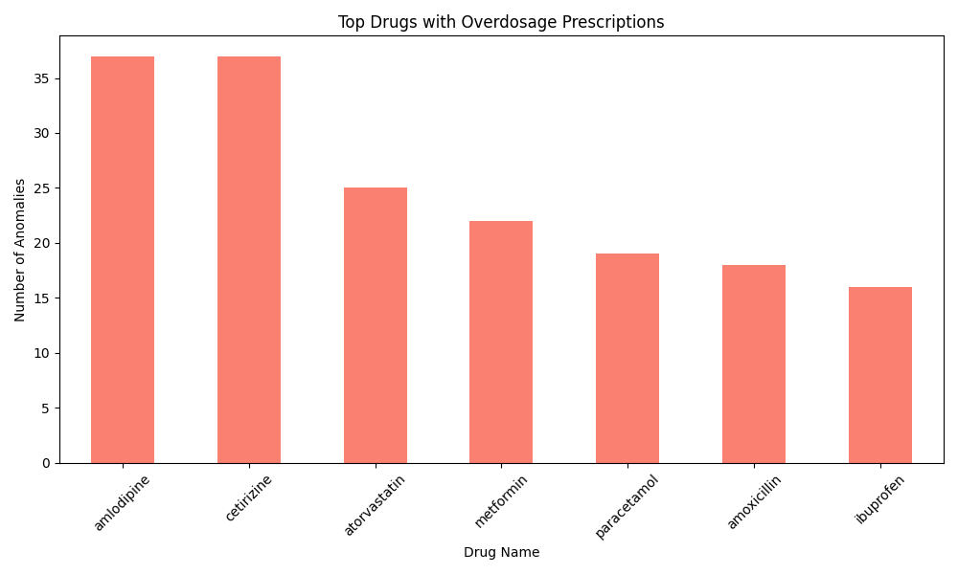
Anomaly Detection
3
Identify and highlight drugs that were prescribed with dosages exceeding the safe or limited levels.
2
Drugs like Amlodipine and Cetirizine have the highest number of overdose prescriptions.
1
Filtered prescriptions where the average dosage exceeded the standard safe dosage.

Slide 9
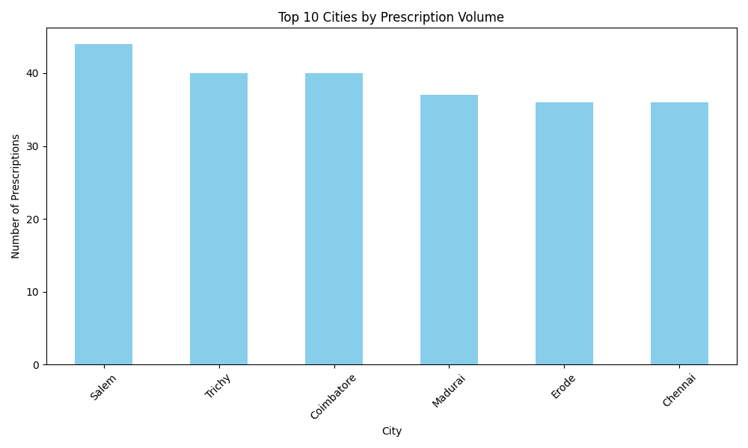
Geographic Analysis

Slide 10
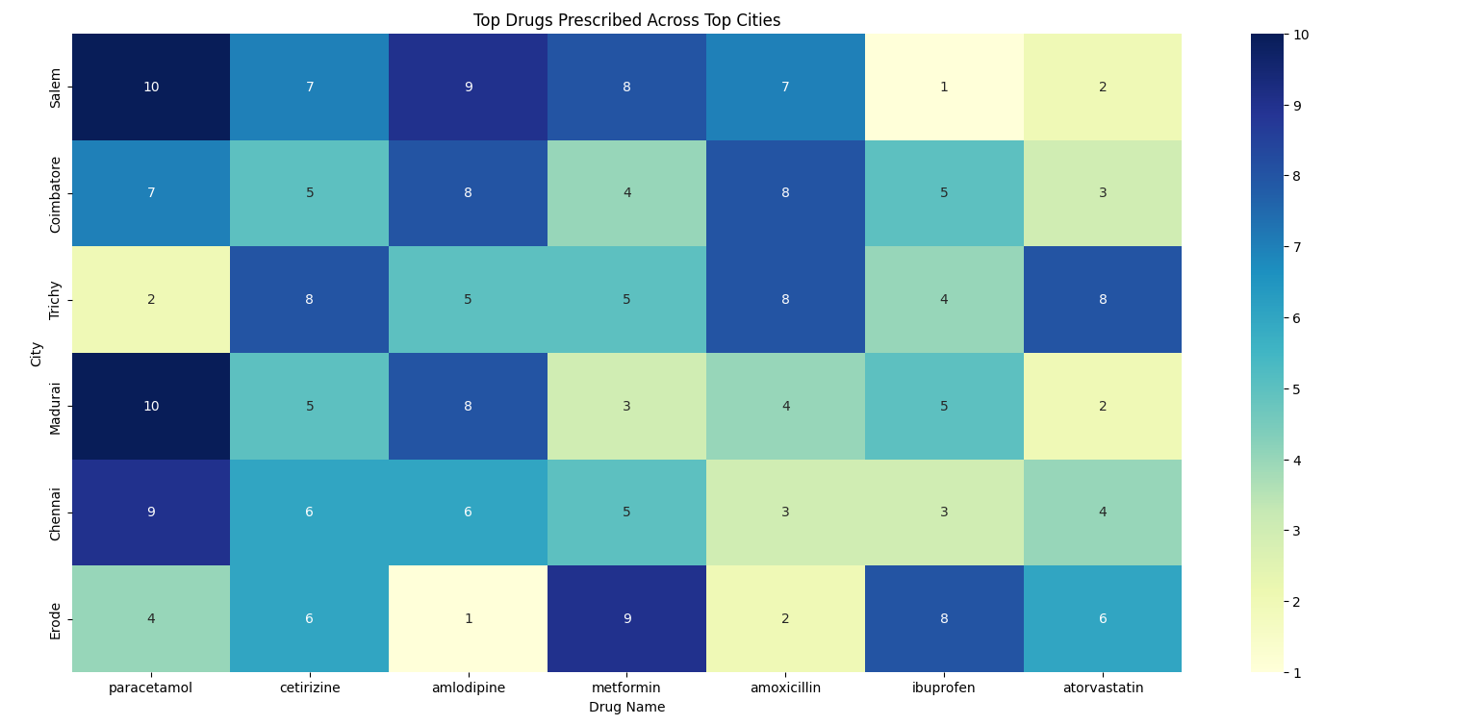
Demographic Analysis
Contoso​
Competitors​
Company A​ Product is more expensive​
Companies B & C ​ Product is expensive and inconvenient to use​
Companies D & E​ Product is affordable, but inconvenient to use
Our product is priced below that of other medical supply companies on the market​
Quick and easy to use, compared to the complex ordering system of the competitors​
Affordability is the main draw for our hospitals to our product​

Slide 11
Key Takeaways
Patient Safety
Promotes Safer Prescribing Practices
Supports Data-Driven Healthcare Planning
A
Regional Insights
DIGITAL Health
B
D
Highlights Regional Health Trends
Lays Foundation for Predictive Healthcare
C
E
Prescription Risk

Slide 12

Path Forward
1. Integrate real-time prescription monitoring with alerts for over-prescription.
2. Expand analysis to include patient recovery data and side effects.
3. Develop dashboards for doctors/pharmacists to aid safer prescribing.
4. Collaborate with health agencies for policy development and awareness.

Slide 13
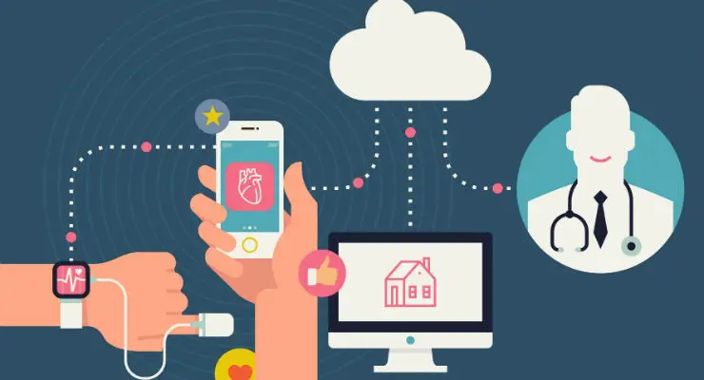
Thank you!!
Powered by Data. Driven by Impact.

